Slide 1
Foil Activation Experiments and Neutron Flux Unfolding
Lt Nick Quartemont
MS Nuclear Engineering 19M
Air Force Institute of Technology
8 Aug 18

Slide 2
Overview
Motivation
Research Plan
Experimental Setup
Foil Activation Theory
Selection of Activation Foils
Neutron Flux Unfolding
STAYSL

Slide 3
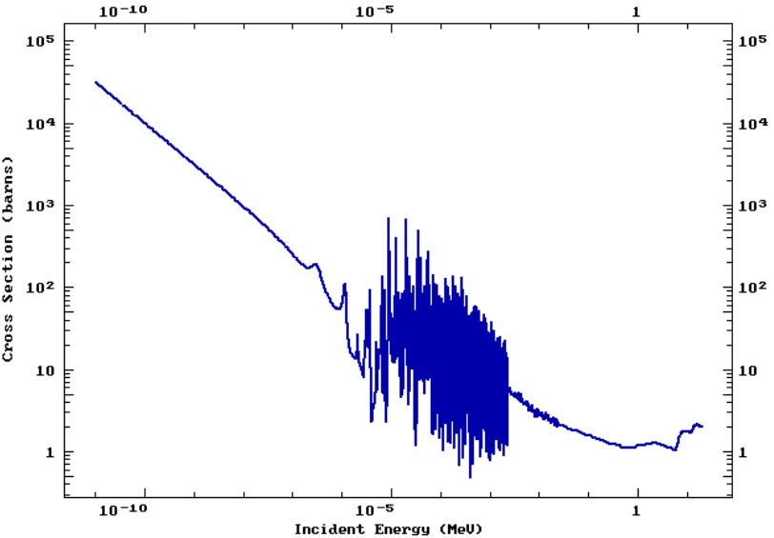
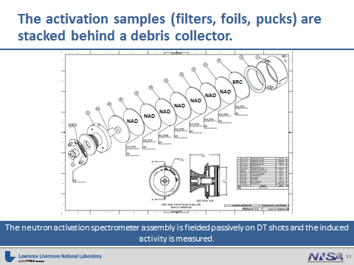
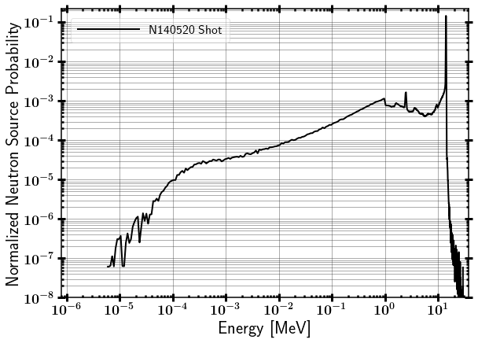
Motivation
Characterization of neutron energy spectrum
Activate foils in experimental environment
Unfold incident neutron spectrum from Nuclear Data and calculated activities to determine a representative result
Nuclear Data * Source Spectrum Foil Activities

Slide 4
Research Plan
(24 July - 3 Aug ) Irradiate foils in Bld 470 pile for 10 days (Foils are In, W, Au, Mn, Al).
(24 July -03 Aug) Characterize HPGe in Rm 105
(03 Aug) Measure Al, Indium and Manganese Activation foils
(03 Aug – 06 Aug) Measure Tungsten and Gold foils
(2-9 Aug) Analysis and preparation for research update
(9 Aug) Research Update
(9-16 Aug) Draft Project Article
(9-21 Aug) Spectrum Unfolding Using STAYSL
(16-23 Aug) Create Lab Procedures
(21 Aug) Lab Notebook
(21-30 Aug) Final Project Article

Slide 5
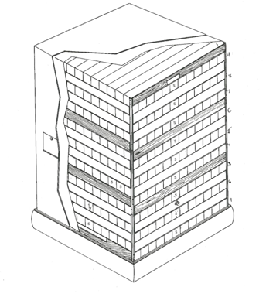
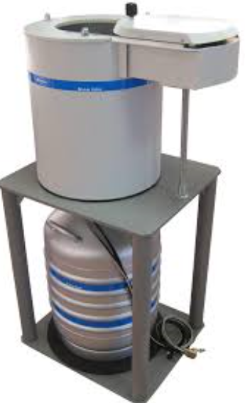
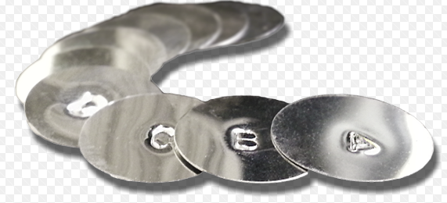
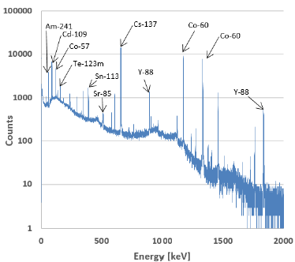
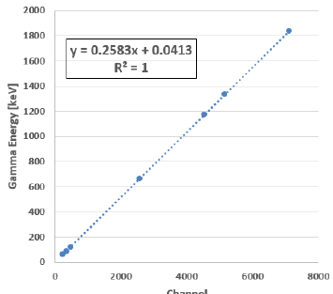
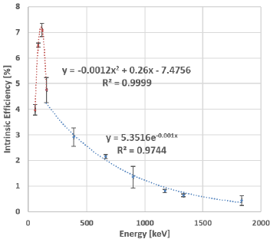
Experiment Overview
Experiment
HPGe
Time Corrected Foil Activities
1 week
irradiation
Multi-nuclide source Energy Calibration Efficiency Calibration

Slide 6
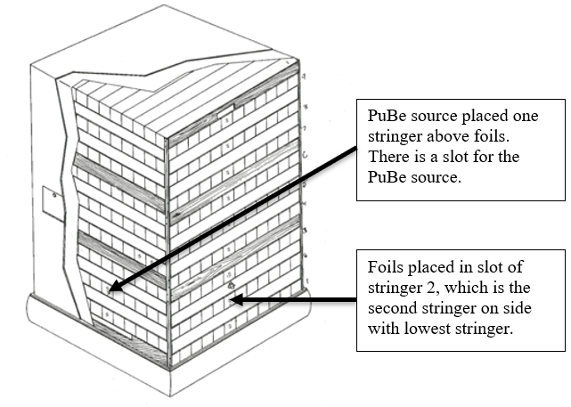
Experimental Setup (Plan) - Irradiation

Slide 7
Irradiation
PuBe Source Energy Distribution Inside Pile
- Planned 7 day irradiation

Slide 8
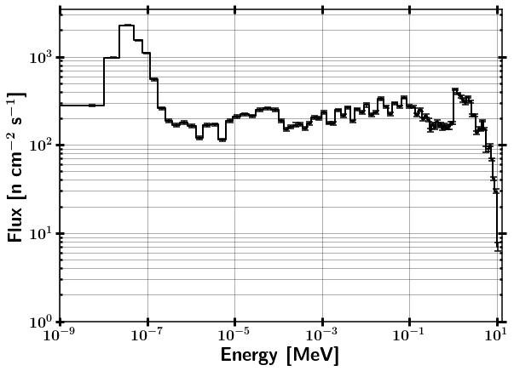
Foil Neutron Environment

Slide 9
Experiment Progress
Experiment
HPGe
Time Corrected Foil Activities
1 week
irradiation
Multi-nuclide source Energy Calibration Efficiency Calibration

Slide 10
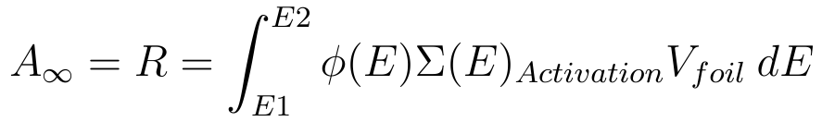
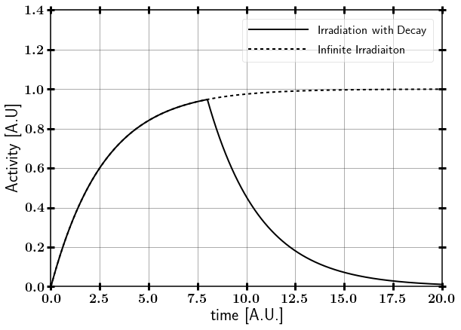
Foil Activation
Saturation Activity

Slide 11
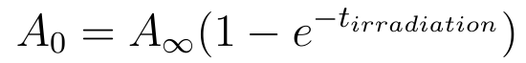
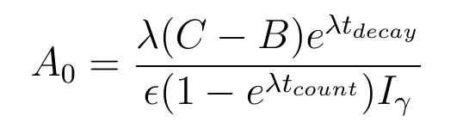
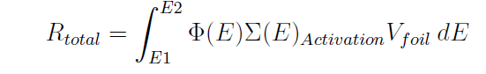
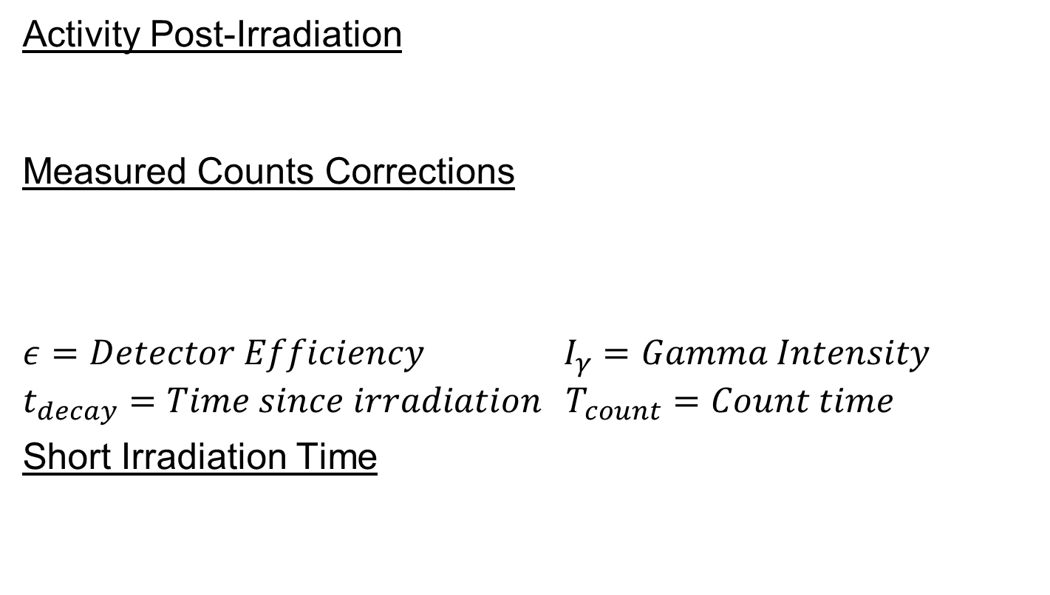
Foil Activation
Activity Post-Irradiation
Measured Counts Corrections
$$ε=Detector Efficiency I_{γ}=Gamma Intensity$$
$$t_{decay}=Time since irradiation T_{count}=Count time$$
Short Irradiation Time

Slide 12
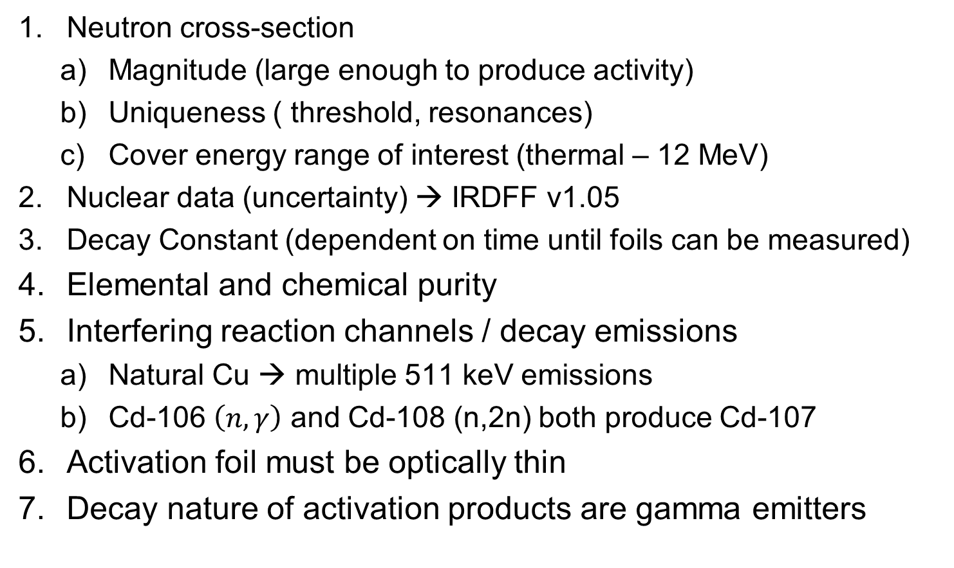
Selection of Activation Foils
Neutron cross-section
Magnitude (large enough to produce activity)
Uniqueness ( threshold, resonances)
Cover energy range of interest (thermal – 12 MeV)
Nuclear data (uncertainty) → IRDFF v1.05
Decay Constant (dependent on time until foils can be measured)
Elemental and chemical purity
Interfering reaction channels / decay emissions
Natural Cu → multiple 511 keV emissions
Cd-106 $\left(n,γ\right)$ and Cd-108 (n,2n) both produce Cd-107
Activation foil must be optically thin
Decay nature of activation products are gamma emitters

Slide 13
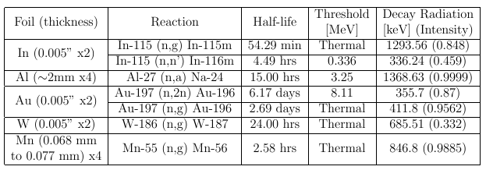
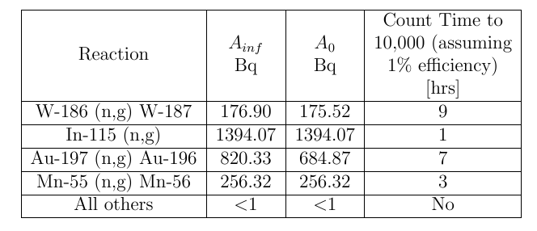
Selected Foils for Pile
All values under 1% Statistical Uncertainty
https://www.tablesgenerator.com/

Slide 14
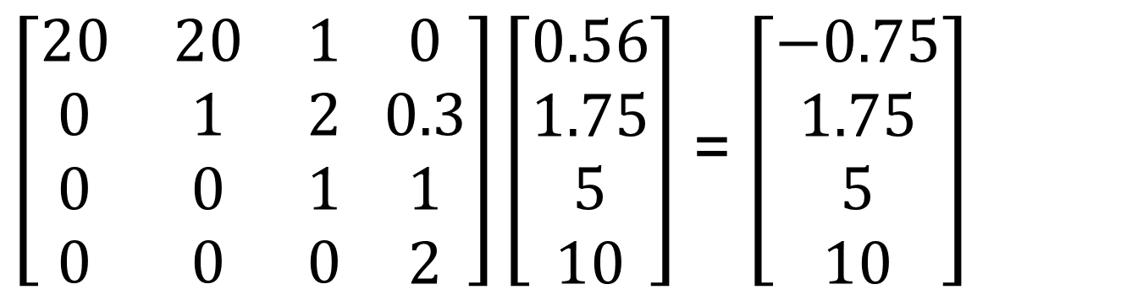
Neutron Flux Unfolding
If you knew everything… it is just doing a matrix inversion of the reaction group averaged cross-section.
Reaction Matrix [cm^2] Flux [n/cm^2-s] Reaction Rate [1/s]
(n,g)
(n,n’)
(n,2n)
(n,2n)
$\left[\begin{matrix}20 & 20 & 1 \\ 0 & 1 & 2 \\ 0 & 0 & 1 \\ 0 & 0 & 0\end{matrix} \begin{matrix}0 \\ 0.3 \\ 1 \\ 2\end{matrix}\right]\left[\begin{matrix}0.56 \\ 1.75 \\ 5 \\ 10\end{matrix}\right]$ = $\left[\begin{matrix}−0.75 \\ 1.75 \\ 5 \\ 10\end{matrix}\right]$

Slide 15
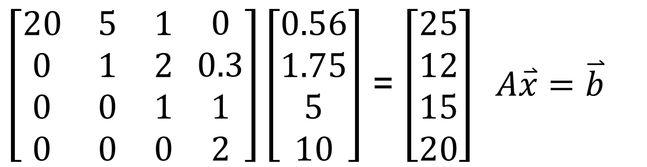
Neutron Flux Unfolding
If you knew everything… it is just doing a matrix inversion of the reaction group averaged cross-section.
Reaction Matrix [cm^2] Flux [n/cm^2-s] Reaction Rate [1/s]
(n,g)
(n,n’)
(n,2n)
(n,2n)
$\left[\begin{matrix}20 & 5 & 1 \\ 0 & 1 & 2 \\ 0 & 0 & 1 \\ 0 & 0 & 0\end{matrix} \begin{matrix}0 \\ 0.3 \\ 1 \\ 2\end{matrix}\right]\left[\begin{matrix}0.56 \\ 1.75 \\ 5 \\ 10\end{matrix}\right]$ = $\left[\begin{matrix}25 \\ 12 \\ 15 \\ 20\end{matrix}\right] A\overset{⃑}{x}=\overset{⃑}{b}$
Does not work because:
Measurement Error
Too broad of bin structure (Can get thermal to fast ratio – Cd)
Adding too many foils to create a large bin structure is counter to being optically thin

Slide 16
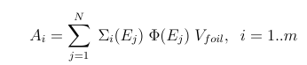
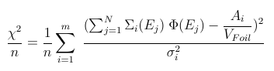
Unfolding Solution Methods
Not a complete list (follows most optimization routines)
Matrix inversion
Degeneracies
Bad way
Can lead to non-physical results
Least-square spectral adjustment (ex. PNNL STAYSL)
Incorporates uncertainty
Incorporates covariance
Requires guess spectrum
Degenerate solutions exist → Guess spectrum applies physics to constrain the end-point result.
Monte Carlo, deterministic, “back of the envelope”, published results
Stochastic methods

Slide 17
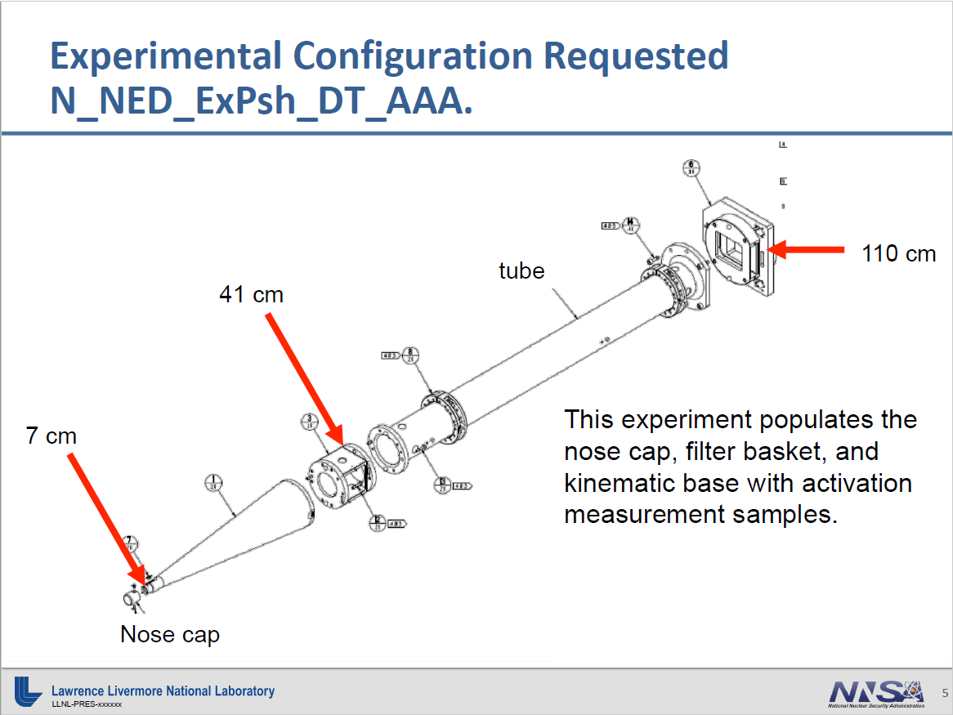
NIF Snout Foil Activation Experiment
Kinematic Base
Basket
Pinhole
- Compare deviations from
expected results

Slide 18
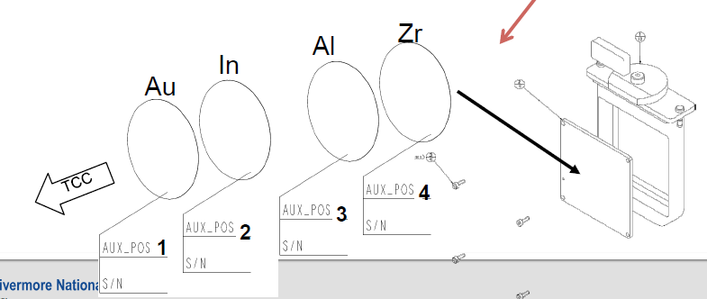
NIF Snout Foil Activation Experiment
Difference from Pile experiment: sizes and Zr
Zr-90 (n,2n) Zr-89, 78 hr half-life, gamma 909 keV (0.9904)

Slide 19
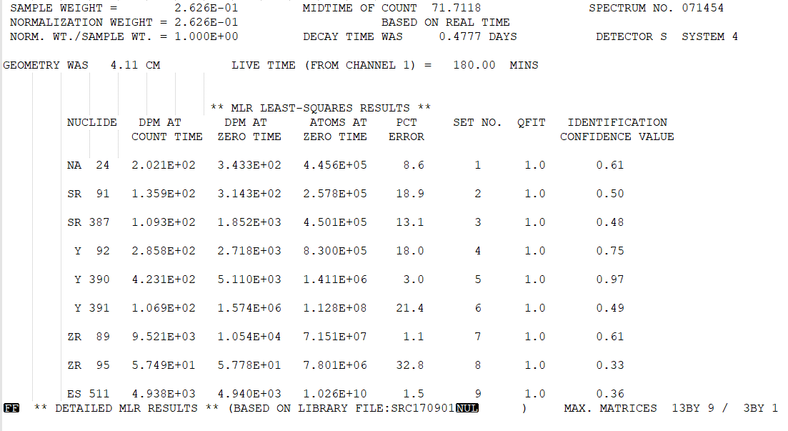
Following from HPGe Results

Slide 20
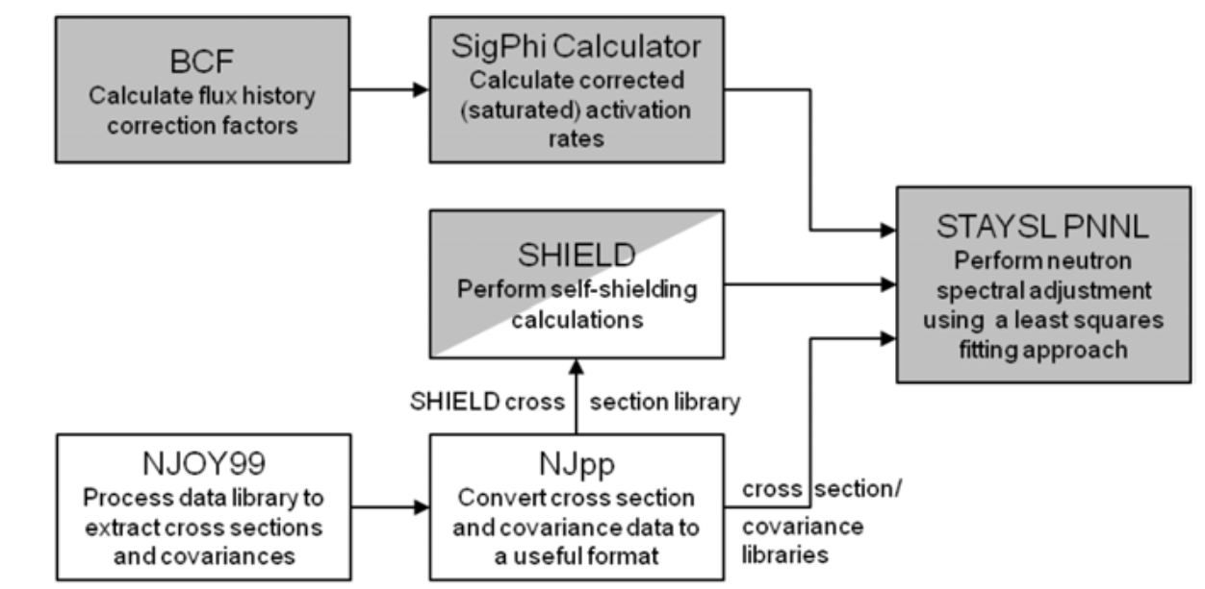
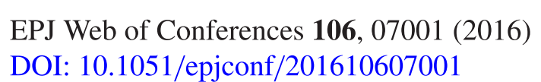
PNNL STAYSL

Slide 21
BCF / SHIELD
BCF not used.
NIF shot is 200 ps (longer when taking reactions into consideration).
Does not impact results as the half-lives of measured products are comparatively long.
SHIELD
Calculates energy-dependent neutron self-shielding cross section correction factors that are used
SHIELD is only necessary/valid on non-threshold reactions (n,gamma).

Slide 22
STAYSL - Guess Spectrum

Slide 23
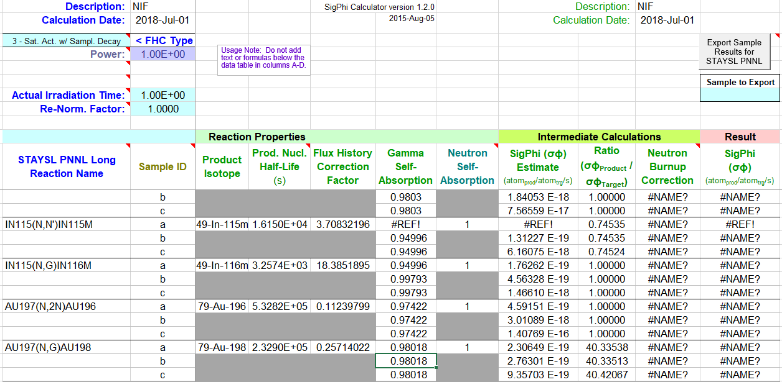
SIG-PHI Guess Spectrum
Did not work for me
Excel macro/version issue

Slide 24
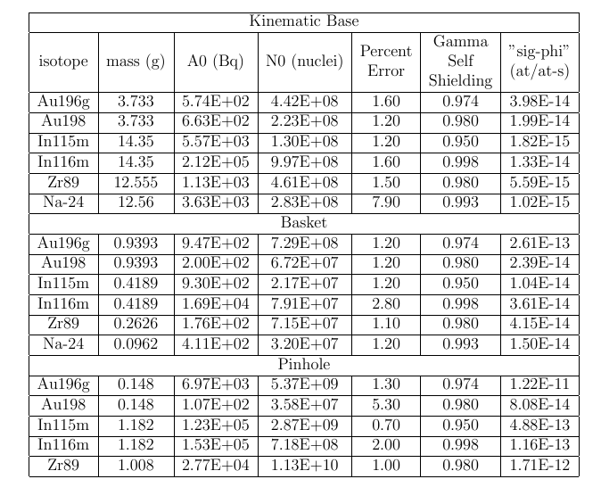
Experimental Input to STAYSL

Slide 25
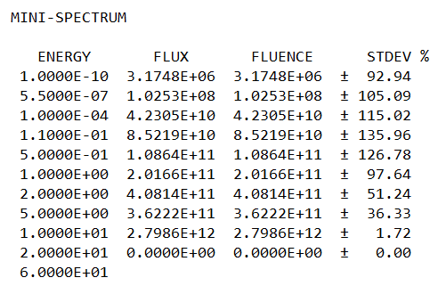
Iterative Unfolding
Start with guess spectrum
Use evaluation from STAYSL as guess for new spectrum
Start with 100% uncertainty in energy regions where little is known
Constrain future iterations with error produced in mini-spectrum
Run until chi-square has stabilized

Slide 26
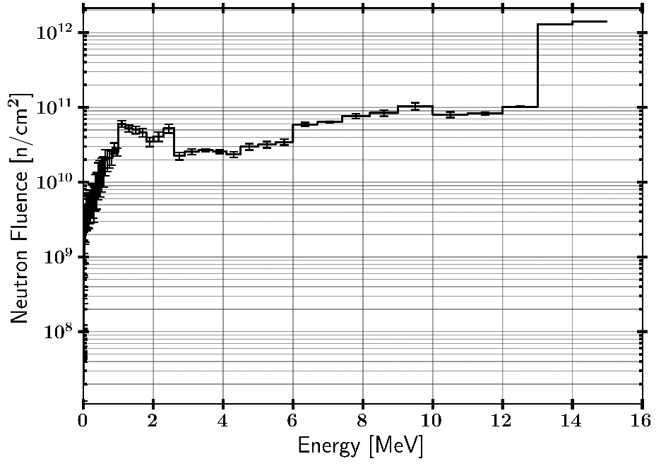
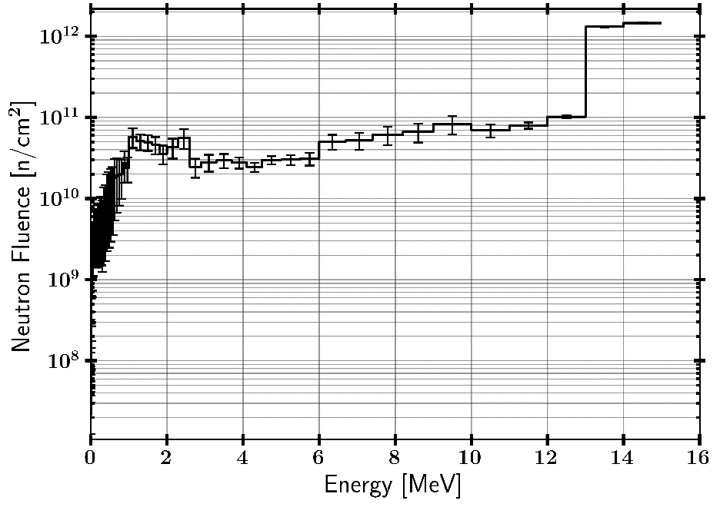
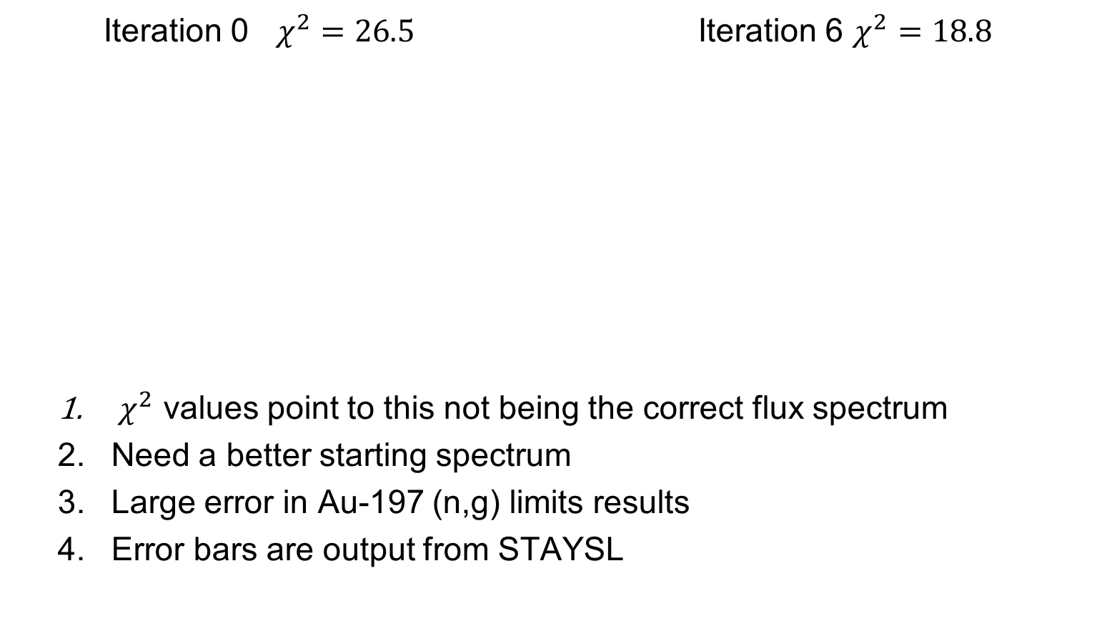
Pinhole Iterative Results
Iteration 0 $χ^{2}=26.5$ Iteration 6 $χ^{2}=18.8$
$χ^{2}$ values point to this not being the correct flux spectrum
Need a better starting spectrum
Large error in Au-197 (n,g) limits results
Error bars are output from STAYSL

Slide 27

Questions

